Slide 1


Funnels with Warby Parker
Learn SQL from Scratch
Bethlehem Mesfin
August 4th, 2018

Slide 2
Agenda
Get familiar with Warby Parker
What is the Quiz Funnel
A/B Testing with Home Try-On Funnel

Slide 3
SELECT *
FROM survey
LIMIT 10;
From our survey table we can highlight the questions, unique user ids, and responses by each individual who completed a Style Quiz
question | user_id | Response
1. What are you looking for? | 005e7f99-d48c-4fce-b605-10506c85aaf7 | Women's Styles
2. What's your fit? | 005e7f99-d48c-4fce-b605-10506c85aaf7 | Medium
3. Which shapes do you like? | 00a556ed-f13e-4c67-8704-27e3573684cd | Round
4. Which colors do you like? | 00a556ed-f13e-4c67-8704-27e3573684cd | Two-Tone
1. What are you looking for? | 00a556ed-f13e-4c67-8704-27e3573684cd | I'm not sure. Let's skip it.
2. What's your fit? | 00a556ed-f13e-4c67-8704-27e3573684cd | Narrow
5. When was your last eye exam? | 00a556ed-f13e-4c67-8704-27e3573684cd | <1 Year
3. Which shapes do you like? | 00bf9d63-0999-43a3-9e5b-9c372e6890d2 | Square
5. When was your last eye exam? | 00bf9d63-0999-43a3-9e5b-9c372e6890d2 | <1 Year
2. What's your fit? | 00bf9d63-0999-43a3-9e5b-9c372e6890d2 | Medium
Q1

Slide 4
SELECT question,
COUNT(DISTINCT user_id)
FROM survey
GROUP BY question;
A high level overview can show us the number of responses to each question. From the table, we can see the gradual decline of the responses
question | COUNT(DISTINCT user_id)
1. What are you looking for? | 500
2. What's your fit? | 475
3. Which shapes do you like? | 380
4. Which colors do you like? | 361
5. When was your last eye exam? | 270
According to Quiz results, 100% of people know what they’re looking for!
Q2

Slide 5
SELECT question,
COUNT(DISTINCT user_id)
FROM survey
GROUP BY question;
When was your last eye exam?
question | COUNT(DISTINCT user_id) | Percentage Completion
1. What are you looking for? | 500 | 100%
2. What's your fit? | 475 | 95%
3. Which shapes do you like? | 380 | 76%
4. Which colors do you like? | 361 | 72%
5. When was your last eye exam? | 270 | 54%
Being that this typically happens on an annual basis, the low completion percentage can be attributed to not being able to recall or being unsure of their last eye exam.
Q3

Slide 6
Take Style Quiz
Home Try-On
Purchase the Perfect Glasses
We used data from our quiz, home_try_on, and purchase tables to provide us the key components needed to calculate conversion rates
SELECT *
FROM quiz
LIMIT 5;
SELECT *
FROM home_try_on
LIMIT 5;
SELECT *
FROM purchase
LIMIT 5;
Q4

Slide 7
SELECT *
FROM quiz
LIMIT 5;
Quiz Table
user_id
style
fit
shape
color
user_id | style | fit | shape | color
4e8118dc-bb3d-49bf-85fc-cca8d83232ac | Women's Styles | Medium | Rectangular | Tortoise
291f1cca-e507-48be-b063-002b14906468 | Women's Styles | Narrow | Round | Black
75122300-0736-4087-b6d8-c0c5373a1a04 | Women's Styles | Wide | Rectangular | Two-Tone
75bc6ebd-40cd-4e1d-a301-27ddd93b12e2 | Women's Styles | Narrow | Square | Two-Tone
ce965c4d-7a2b-4db6-9847-601747fa7812 | Women's Styles | Wide | Rectangular | Black
Q4.1

Slide 8
SELECT *
FROM home_try_on
LIMIT 5;
Home Try On Table
user_id
number_of_pairs
address
user_id | number_of_pairs | address
d8addd87-3217-4429-9a01-d56d68111da7 | 5 pairs | 145 New York 9a
f52b07c8-abe4-4f4a-9d39-ba9fc9a184cc | 5 pairs | 383 Madison Ave
8ba0d2d5-1a31-403e-9fa5-79540f8477f9 | 5 pairs | 287 Pell St
4e71850e-8bbf-4e6b-accc-49a7bb46c586 | 3 pairs | 347 Madison Square N
3bc8f97f-2336-4dab-bd86-e391609dab97 | 5 pairs | 182 Cornelia St
Q4.2

Slide 9
SELECT *
FROM purchase
LIMIT 5;
Purchase Table
user_id
product_id
style
model_name
color
Price
user_id | product_id | style | model_name | color | Price
00a9dd17-36c8-430c-9d76-df49d4197dcf | 8 | Women's Styles | Lucy | Jet Black | 150
00e15fe0-c86f-4818-9c63-3422211baa97 | 7 | Women's Styles | Lucy | Elderflower Crystal | 150
017506f7-aba1-4b9d-8b7b-f4426e71b8ca | 4 | Men's Styles | Dawes | Jet Black | 150
0176bfb3-9c51-4b1c-b593-87edab3c54cb | 10 | Women's Styles | Eugene Narrow | Rosewood Tortoise | 95
01fdf106-f73c-4d3f-a036-2f3e2ab1ce06 | 8 | Women's Styles | Lucy | Jet Black | 150
Q4.3

Slide 10
SELECT DISTINCT q.user_id,
h.user_id IS NOT NULL 'is_home_try_on',
h.number_of_pairs,
p.user_id IS NOT NULL 'is_purchase'
FROM quiz AS 'q'
LEFT JOIN home_try_on AS 'h'
ON q.user_id = h.user_id
LEFT JOIN purchase AS 'p'
ON p.user_id = q.user_id
LIMIT 10;
By combining the three tables, we can get a more detailed look at the customer Home Try On experience
user_id | is_home_try_on | number_of_pairs | is_purchase
4e8118dc-bb3d-49bf-85fc-cca8d83232ac | 1 | 3 pairs | 0
291f1cca-e507-48be-b063-002b14906468 | 1 | 3 pairs | 1
75122300-0736-4087-b6d8-c0c5373a1a04 | 0 | NULL | 0
75bc6ebd-40cd-4e1d-a301-27ddd93b12e2 | 1 | 5 pairs | 0
ce965c4d-7a2b-4db6-9847-601747fa7812 | 1 | 3 pairs | 1
user_id | is_home_try_on | number_of_pairs | is_purchase
28867d12-27a6-4e6a-a5fb-8bb5440117ae | 1 | 5 pairs | 1
5a7a7e13-fbcf-46e4-9093-79799649d6c5 | 0 | NULL | 0
0143cb8b-bb81-4916-9750-ce956c9f9bd9 | 0 | NULL | 0
a4ccc1b3-cbb6-449c-b7a5-03af42c97433 | 1 | 5 pairs | 0
b1dded76-cd60-4222-82cb-f6d464104298 | 1 | 3 pairs | 0
Q5

Slide 11
Results

Slide 12
WITH funnels AS (SELECT DISTINCT q.user_id,
h.user_id IS NOT NULL 'is_home_try_on',
h.number_of_pairs,
p.user_id IS NOT NULL 'is_purchase'
FROM quiz AS 'q'
LEFT JOIN home_try_on AS 'h'
ON q.user_id = h.user_id
LEFT JOIN purchase AS 'p'
ON p.user_id = q.user_id)
SELECT COUNT(*) AS 'num_quiz',
SUM(is_home_try_on) AS 'num_home_try_on',
SUM(is_purchase) AS 'num_purchase',
1.0 * SUM(is_purchase) / COUNT(user_id) AS 'overall_conv_rate',
1.0 * SUM(is_home_try_on) / COUNT(user_id) AS 'quiz_to_home_try_on',
1.0 * SUM(is_purchase) / SUM(is_home_try_on) AS 'home_try_on_to_purchase'
FROM funnels;
Quiz → Home Try On Rate: 75% Home Try On → Purchase : 66%
num_quiz | num_home_try_on | num_purchase | overall_conv_rate | quiz_to_home_try_on | home_try_on_to_purchase
1000 | 750 | 495 | 0.495 | 0.75 | 0.66
Q6.1,6.2

Slide 13
Customers who tried on 5 pairs have a higher purchase rate
WITH funnels AS (SELECT DISTINCT q.user_id,
h.user_id IS NOT NULL 'is_home_try_on',
h.number_of_pairs,
p.user_id IS NOT NULL 'is_purchase'
FROM quiz AS 'q'
LEFT JOIN home_try_on AS 'h'
ON q.user_id = h.user_id
LEFT JOIN purchase AS 'p'
ON p.user_id = q.user_id)
SELECT number_of_pairs,
COUNT(*) AS 'num_quiz',
SUM(is_home_try_on) AS 'num_home_try_on',
SUM(is_purchase) AS 'num_purchase',
1.0 * SUM(is_home_try_on) / COUNT(user_id) AS 'quiz_to_home_try_on',
1.0 * SUM(is_purchase) / SUM(is_home_try_on) AS 'home_try_on_to_purchase'
FROM funnels
GROUP BY number_of_pairs;
number_of_pairs | num_quiz | num_home_try_on | num_purchase | quiz_to_home_try_on | home_try_on_to_purchase
NULL | 250 | 0 | 0 | 0.0 | NULL
3 pairs | 379 | 379 | 201 | 1.0 | 0.530343007915567
5 pairs | 371 | 371 | 294 | 1.0 | 0.792452830188679
Q6.3

Slide 14
SELECT response,
question,
COUNT(DISTINCT user_id)
FROM survey
GROUP BY 1
ORDER BY 3 DESC;
Our most common answer was focused on looking for Men’s Styles and a narrow fit
response | question | COUNT(DISTINCT user_id)
Men's Styles | 1. What are you looking for? | 242
Women's Styles | 1. What are you looking for? | 209
Narrow | 2. What's your fit? | 208
<1 Year | 5. When was your last eye exam? | 141
Rectangular | 3. Which shapes do you like? | 141
Medium | 2. What's your fit? | 132
Square | 3. Which shapes do you like? | 119
Tortoise | 4. Which colors do you like? | 117
Black | 4. Which colors do you like? | 112
I'm not sure. Let's skip it. | 1. What are you looking for? | 92
response | question | COUNT(DISTINCT user_id)
Round | 3. Which shapes do you like? | 91
Wide | 2. What's your fit? | 88
Crystal | 4. Which colors do you like? | 69
1-3 Years | 5. When was your last eye exam? | 56
3+ Years | 5. When was your last eye exam? | 37
Neutral | 4. Which colors do you like? | 36
Not Sure. Let's Skip It | 5. When was your last eye exam? | 36
No Preference | 3. Which shapes do you like? | 29
Two-Tone | 4. Which colors do you like? | 27
Q6.4

Slide 15
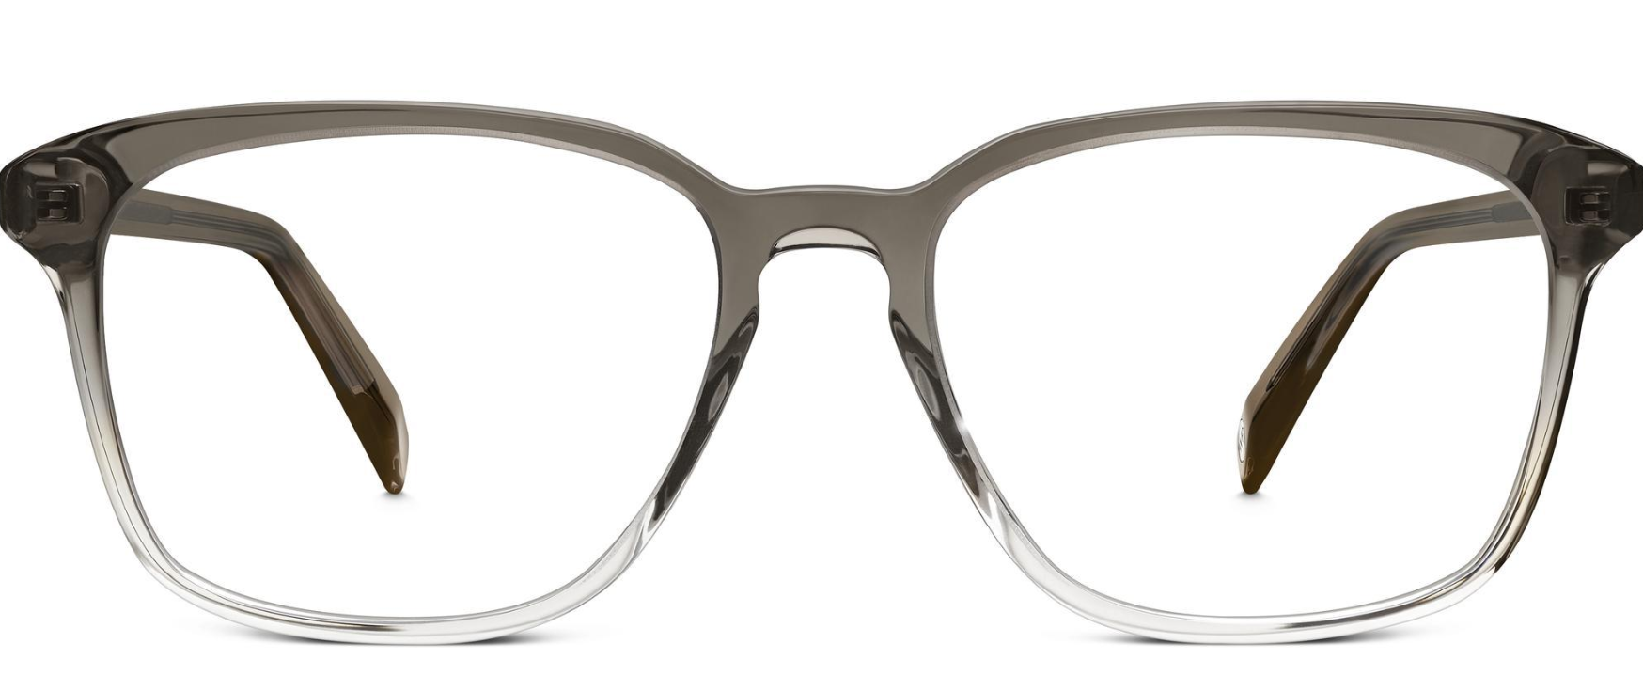
SELECT product_id,model_name,color,price,
COUNT(DISTINCT user_id)
AS 'total_number_of_purchases'
FROM purchase
GROUP BY 1
ORDER BY 5 DESC;
The most common purchase was the Dawes model in Driftwood Fade
product_id | model_name | color | price | total_number_of_purchases
3 | Dawes | Driftwood Fade | 150 | 63
10 | Eugene Narrow | Rosewood Tortoise | 95 | 62
9 | Eugene Narrow | Rose Crystal | 95 | 54
1 | Brady | Layered Tortoise Matte | 95 | 52
6 | Olive | Pearled Tortoise | 95 | 50
4 | Dawes | Jet Black | 150 | 44
7 | Lucy | Elderflower Crystal | 150 | 44
2 | Brady | Sea Glass Gray | 95 | 43
8 | Lucy | Jet Black | 150 | 42
5 | Monocle | Endangered Tortoise | 50 | 41
Q6.5

Slide 16
THANK YOU

